Slide 1
Task Scheduling in Big Data
                Presentation By Siddhartha Ireddy

Slide 2
Task Scheduling in Big Data
Presents the state-of-art of various types of task scheduling algorithms, scheduling considerations for batch and streaming processing, and task scheduling algorithms in the well known open-source big data platforms
The process of scheduling the tasks into the cluster resources in a manner that minimizes task completion time and resource utilization is known as Task Scheduling.

Slide 3
Static Task Scheduling
The main objective of the static task scheduling strategy is to reduce the scheduling overhead that occurs during the runtime and minimize the number of nodes/processors.
Disadvantages: static task scheduling algorithms are that they don’t consider the workload of the resources and resource requirements of an application that obviously leads to overutilization or underutilization of the resources which may pave the way for job execution failure.

Slide 4
Examples:
Capacity Scheduling, Data Locality-Aware Scheduling, Round Robin Scheduling, Delay Scheduling, FIFO Scheduling
First Fit Scheduling, Fair Scheduling, Matchmaking Scheduling.

Slide 5
Dynamic Task Scheduling and Algorithms
The dynamic task scheduling takes the scheduling decisions during the runtime of task execution. It mainly considers the resource requirement, availability of resources, interprocess and inter-node traffic, energy efficiency, and more. It also supports task migration which is based on the status of the cluster resources and the workload of an application.
Examples: resource-aware scheduling, energy-aware scheduling, and deadline-aware scheduling. The dynamic task scheduling is mainly aimed to efficiently utilize the resources, minimize the consumption of energy, and complete the jobs within their deadline respectively

Slide 6
Task Scheduling Considerations for batch processing
Hadoop ecosystem describes that all data should be loaded into Hadoop Distributed File System (HDFS) for Batch
task scheduling for batch jobs can be performed prior to processing, based on the knowledge of input data and task information for processing in a distributed environment. In addition, the resources can be statically allocated prior to the execution of a job.

Slide 7
Florin Pop and Valentin Cristea explained processing of big data as a big batch process by splitting a job into multiple tasks and running on a High Performance Computing (HPC) by distributing the work to the cluster nodes.
With batch processing, a single CPU can work on the entire dataset meaning each task will be run on each CPU one after another. Depending on the job, number of CPU’s utilized can be different at each stage of the batch job.

Slide 8
Task Scheduling Considerations for streaming processing
In general, the big data platform receives a large amount of streaming data from input data streams such as data sensors, social networking, IoT devices, and others.
It is difficult to store such large amounts of streaming data hence, it should be processed immediately which requires a lot of computation cycles and memory resources.

Slide 9
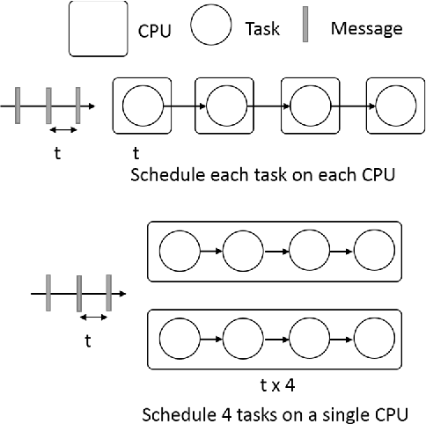
Stream Task Scheduling

Slide 10
Chen Men-meng et al. states that the existing task scheduling algorithms for streaming processing fail to consider the links between the streaming tasks and the dynamicity of the streaming process and the resources.
Boyang Peng said that streaming task components which communicate with each other should be scheduled close to the network proximity to avoid the network delay.
Dawei Sun et al. built a fault tolerant framework for guaranteeing the deadline in a big data streaming computing.

Slide 11
TASK SCHEDULING IN BIG DATA PLATFORMS OR TOOLS
Apache Hadoop is one of the most popular big data processing frameworks.
It has been implemented with the default scheduling policy of FIFO
Fair Scheduling in Hadoop makes an equal share of computing resources among the users or jobs.
Delay Scheduling in Hadoop is designed to accommodate changes in the existing MapReduce

Slide 12
Capacity Aware Scheduling was introduced by Yahoo with the objective of maximizing the utilization of resources and throughput in a cluster.
Apache Spark is an in-memory big data computation framework. It mainly works on the principle of Resilient Distributed Datasets (RDDs)
It has been implemented both the static and dynamic task scheduling algorithms for those RDDs.

Slide 13
The fair scheduling policy in Spark group the jobs into pools and assign weights to each pool. The dynamic resource allocation policy allocates the resources to the jobs based on the workload of the cluster resources in a dynamic manner.
Derek G. Murray et al. designed a timely dataflow system known as Naiad for executing data parallel, cyclic dataflow applications.

Slide 14
Aurora is a Mesos framework or a service scheduler running on top of Apache Mesos. It facilitates to run longrun jobs, cron jobs, and adhoc jobs. In general, Mesos is concerned about individual tasks whereas a job consists of multiple task instances.
REEF (Retainable Evaluator Execution Framework)[45] provides a control plane to schedule and coordinate data plane on cluster resources for data processing applications.

Slide 15
Overview of Twister2
Supun Kamburugamuwa Geoffrey Fox proposed a Big data programming toolkit named Twister2 empowered with the dataflow programming model.
It has the ability to handle different kind of jobs namely batch jobs, stream processing, Message Passing Interface (MPI), and Microservices.

Slide 16
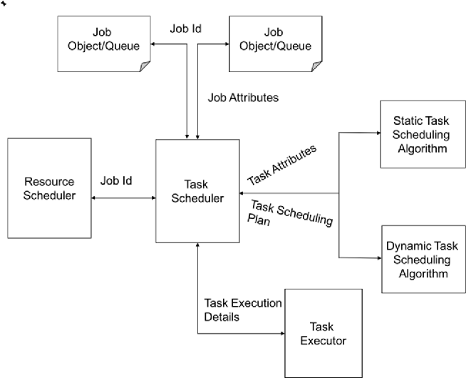
Task Scheduling in Twister2

Slide 17
Task Scheduling Model
It comprises of Job Model, Resource Model, Performance Metrics, Scheduling Policy, and Programming Model
Job model - It provides the abstraction of jobs (consists of multiple tasks) and its requirements. The requirements are classified into hard and soft constraints. The job model handles different type of jobs namely batch, streaming, MPI, and microservices.

Slide 18
Resource model - It describes the characteristics and performances of data centers, hosts, rack, and network links. The resource model maintains the metadata that contains resource characteristics in terms of properties and value.
• Scheduling policy/algorithm - The scheduling policy or algorithm implemented in Task Scheduler which is based on specific goals such as optimization of total computational time or utilization of cluster resourc

Slide 19
Performance metrics - It is used to evaluate the performance improvements gained by the proposed task scheduling model. In our proposed work, we have considered and evaluated the various performance metrics.
• Programming model - The programming model is helpful for providing the interface to the scheduler. In this proposed approach, we have made use of dataflow programming model for interfacing the task scheduler with other components.

Slide 20
Task Scheduling System in Twister2
Facilitates to schedule both static and dynamic task graphs
The task scheduler is integrated with static as well as dynamic task scheduling algorithms.
The task scheduler invokes an appropriate algorithm based on the application, input data, and the source of input data.

Slide 21
Conclusion
It has been identified that there is no common task scheduling model to accommodate both the static and dynamic task graphs and handle different type of jobs as discussed above.
Hence, the proposed task scheduling model is able to handle both static and dynamic task scheduling

Slide 22
it has the ability to schedule different types of jobs namely batch, streaming, MPI, and microservices which are missing in other existing works.
Furthermore, the proposed task scheduling model considers both the user-centric and resource-centric performance factors

